Slide 1
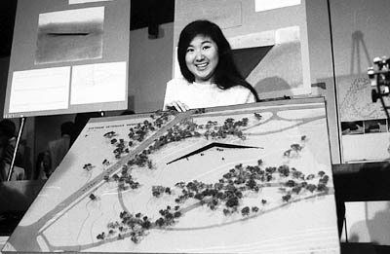
The Origins of the Vietnam War Memorial
Began as a national contest with prize of $50,000
Specifications for contestants included simple design and no political judgements about the war
Winning design was completed by Maya Lin, a Vietnamese refugee of the war

Slide 2
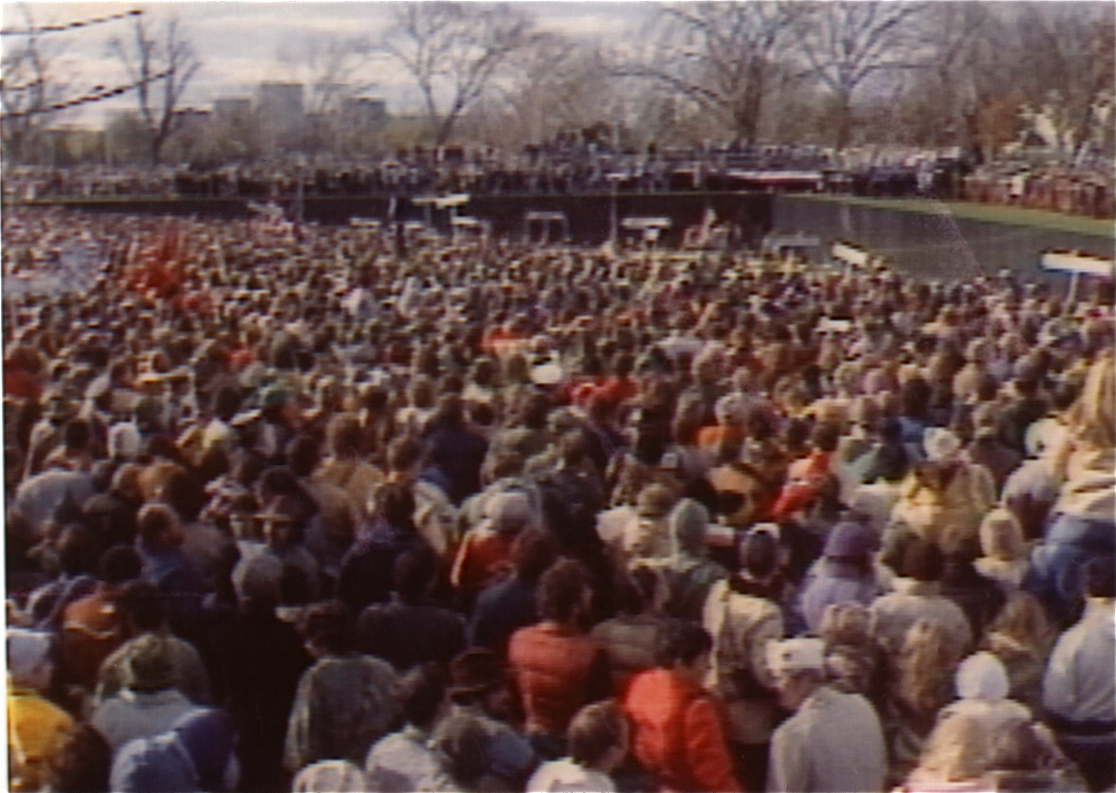
Construction and Completion
1st ground is broken on March 26, 1982
The black granite used for the wall is ordered from India.
Cutting and fabrication of the stone is completed in Barre, VT .
The project was completed and dedicated in the same year, on November 13, 1982.

Slide 3
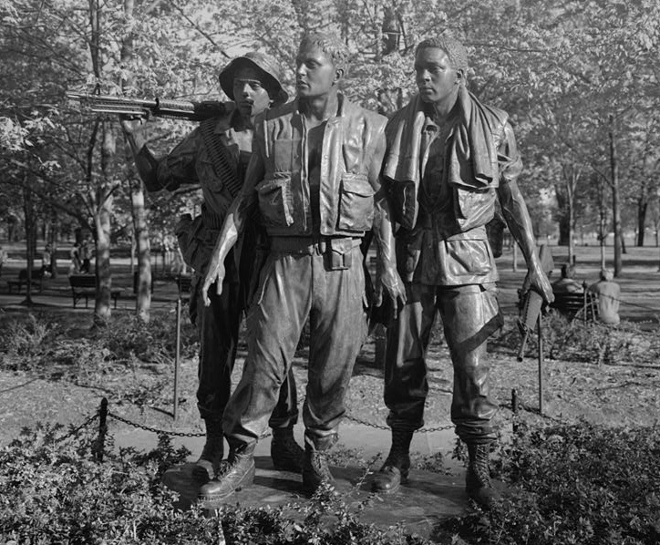
Further Additions to the Memorial
The 3 Soldiers Statue is completed and dedicated in November 1984
The Vietnam Women's Memorial is completed and dedicated November 11, 1993.
Memorial plaque is dedicated to those who died of wounds post-war November 10, 2004.

